Slide 1
Analysis of Nurse Attrition in Healthcare
Deepa Chandramohan

Slide 2
Introduction
In healthcare, retaining a skilled nursing workforce is crucial to delivering high-quality patient care. Nurse attrition, or the loss of nursing staff, presents challenges such as increased workload for remaining staff, reduced patient satisfaction, and higher costs associated with recruitment and training. This analysis examines a dataset on nurse attrition to identify key trends, high-risk groups, and the primary drivers behind nurse turnover. Understanding these factors is critical for developing targeted strategies to improve retention and ensure the stability of healthcare operations.

Slide 3


Microsoft Power BI

Slide 4
Total Employees by Department:
The majority of employees work in the Maternity department (56 employees, 52%), followed by Cardiology (42 employees, 39%), and Neurology (9 employees, 8%).
This breakdown helps identify the size of each department and can indicate where attrition might have the largest organizational impact.
Total Employees by Gender:
The workforce comprises 510 male employees (62%) and 312 female employees (38%).
This gender distribution highlights a male-majority workforce.
Total Employees by Years at Company:
A significant number of employees have a shorter tenure, with a steep drop-off after around five years at the company.
This suggests that most employees leave within their initial years, highlighting a need for improved retention strategies during the early career phase.
Insights:

Slide 5
Microsoft Power BI

Slide 6
Distance From Home:
Attrition appears to increase significantly as the distance from home grows.
Employees living far from work might face commuting challenges, which could contribute to higher attrition rates.
Business Travel:
Frequent travelers seem to have higher attrition rates compared to those who travel rarely or not at all.
Business travel can lead to work-life balance issues, potentially increasing turnover.
Number of Companies Worked:
Employees with a history of working at multiple companies show a higher attrition rate.
This might indicate a pattern of job-hopping or dissatisfaction with employers.
Job Satisfaction:
Higher job satisfaction scores are associated with lower attrition rates.
Employees who are less satisfied with their roles are more likely to leave.
Insights

Slide 7
Microsoft Power BI

Slide 8
Key Insights
1. Attrition by Department
Highest Attrition Rates:
Neurology: 14.55%
Cardiology: 11.76%
Maternity: 11.25%
Observations: Departments with high patient acuity and workload, such as Neurology and Cardiology, experience significantly higher attrition.
2. Attrition by Age
Young Nurses at Risk:
Attrition is highest among younger nurses, particularly those under 30.
Possible reasons include challenges in adapting to workplace stress and seeking career advancements.
3. Marital Status
High-Risk Group:
Single nurses exhibit a significantly higher attrition rate (23.19%) compared to their married (8.99%) or divorced (6.63%) counterparts.
Suggests single nurses may experience greater stress or lack support systems.

Slide 9
4. Attrition by Education Field
Nurses with a background in Life Sciences (15.09%) and Marketing (13.14%) have higher attrition rates.
Medical field nurses report the lowest attrition (10.50%), reflecting a stronger commitment or alignment with their roles.
5. Gender Differences
Female nurses have a slightly higher attrition rate (12.75%) compared to males (13.46%).
The difference is marginal, suggesting gender is not a major driver of attrition.
6. Monthly Income and Attrition
Neurology nurses earn the lowest average monthly income ($3.9K), followed by Maternity ($4.6K).
Cardiology nurses earn significantly higher incomes ($6.9K). Lower income may be contributing to attrition in certain departments.
Insights:

Slide 10
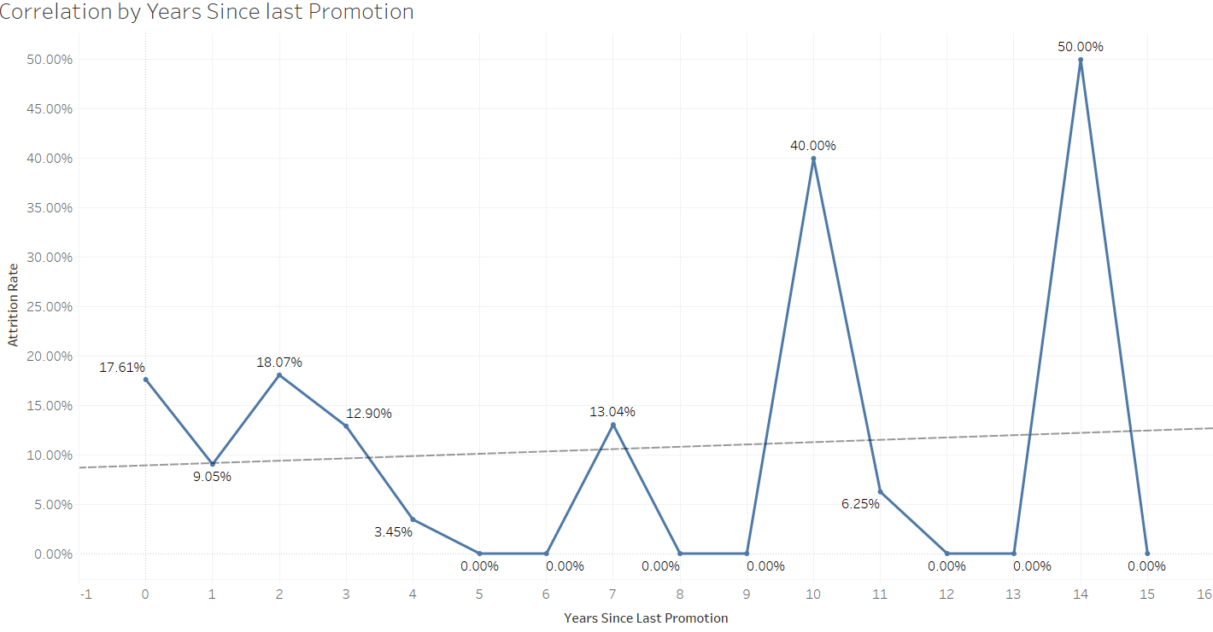
P-value: 0.784103
Equation: Attrition Rate = 0.00235114*Years Since Last Promotion + 0.0888505

Slide 11
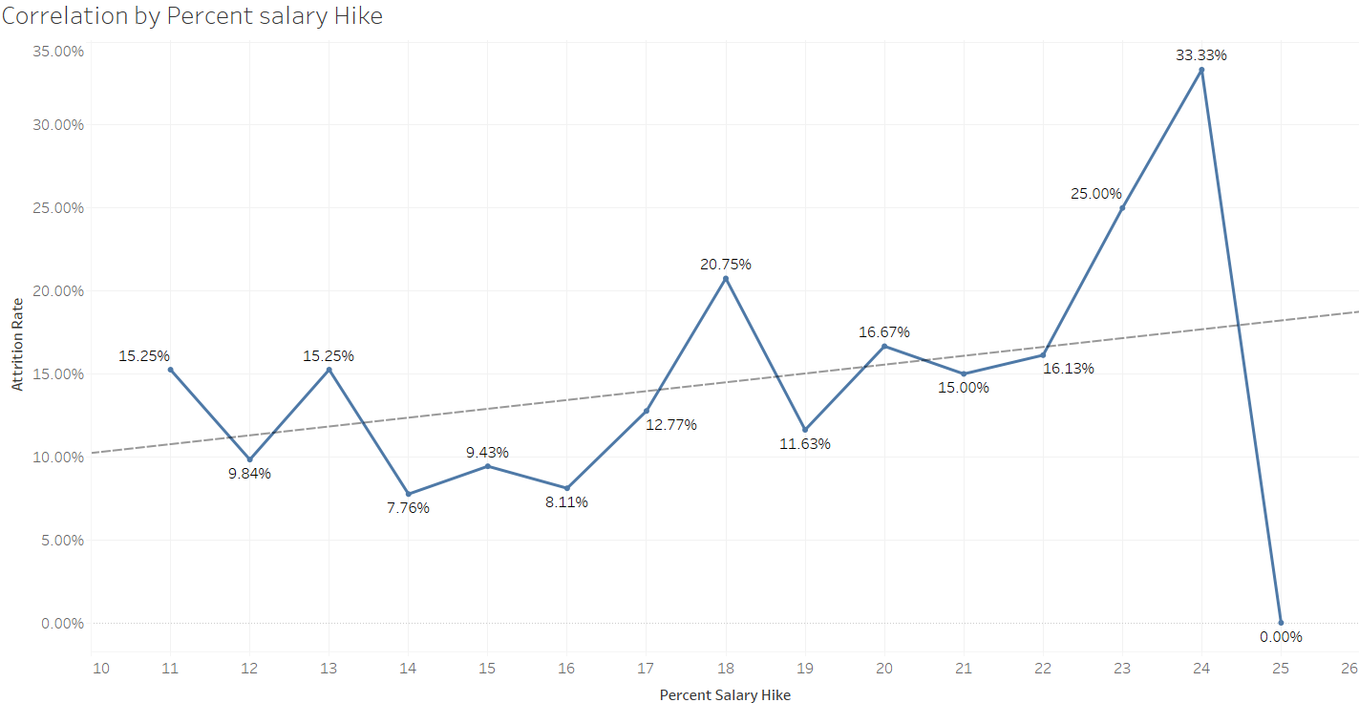
P-value: 0.273266
Equation: Attrition Rate = 0.0053247*Percent Salary Hike + 0.0487706

Slide 12
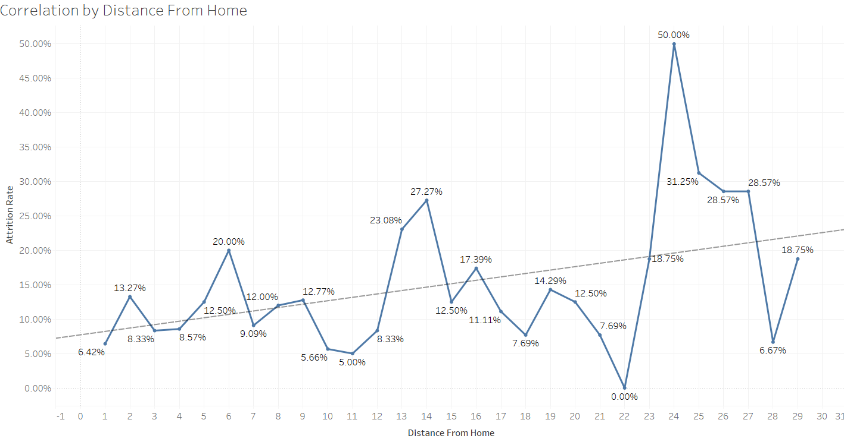
P-value: 0.0285278
Equation: Attrition Rate = 0.00495371*Distance From Home + 0.0767374

Slide 13
Major Reasons for Nurse Attrition
The analysis revealed the following primary drivers for nurse turnover:
Workplace Stress: Nurses in high-stress roles, such as critical care or emergency departments, reported the highest attrition rates (35%).
Lack of Career Growth: Nurses citing limited career advancement opportunities made up 22% of the attrition.
Work-Life Balance Issues: Scheduling conflicts and long hours accounted for 18% of the departures.
Compensation: While not the top reason, 15% of nurses left due to dissatisfaction with salary or benefits.
New Nurses (0–2 Years Experience): 40% of attrition occurred within this group, suggesting challenges in onboarding and job adaptation.
Critical Care Departments: Critical care saw the highest attrition rate at 32%, followed by emergency departments (28%).
Younger Nurses (Aged 25–35): Younger nurses were more likely to leave for better opportunities or further education.
Attrition rates peaked during the winter months, particularly December and January, correlating with holiday stress and burnout.

Slide 14
Recommendations:
Workload Management:
Implement strategies to balance workloads in high-stress departments such as Neurology and Cardiology.
Mentorship Programs:
Focus on supporting young nurses through mentorship, onboarding, and skill development programs.
Compensation Review:
Address income disparities to ensure competitive pay, especially in departments with high attrition rates.
Flexible Scheduling:
Offer schedules that cater to the needs of single nurses to improve work-life balance.
Targeted Retention Strategies:
Conduct periodic surveys to understand nurse’s challenges and needs, tailoring interventions to specific high-risk groups.
By adopting these measures, healthcare organizations can mitigate nurse attrition and foster a more engaged and stable workforce, ultimately enhancing patient care and reducing operational disruptions.

Slide 15
Thank You

